Slide 1
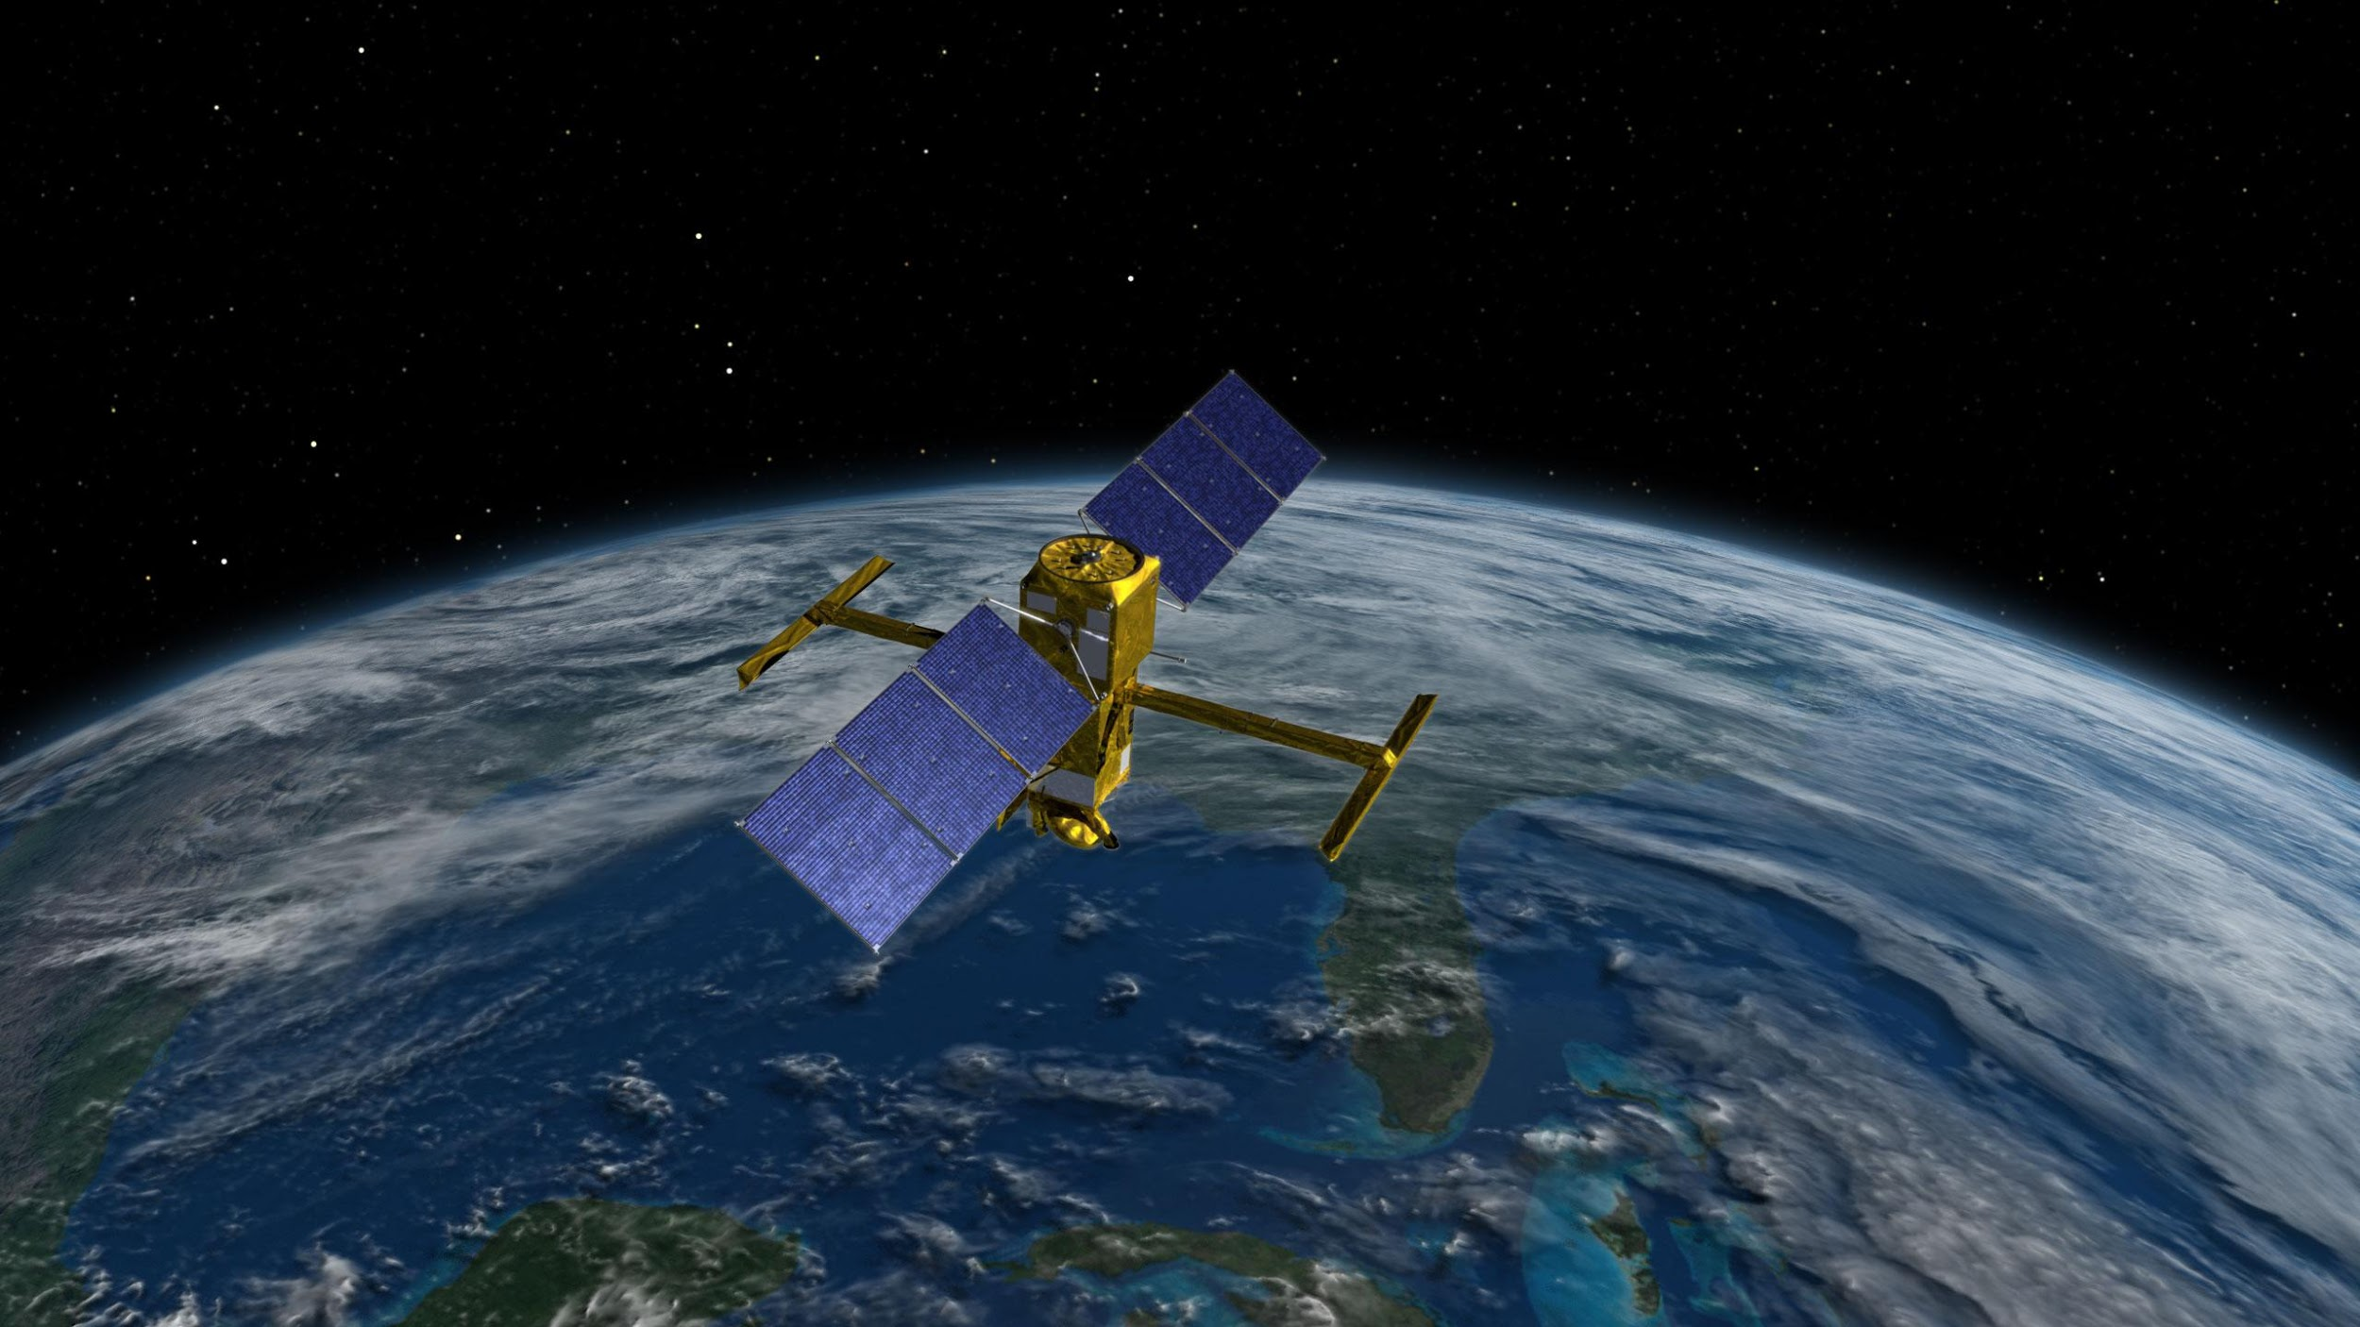
Estimating streamflow with the SWOT satellite
Mark Hagemann, Ph.D.
mhageman@umass.edu

Slide 2

Acknowledgments
NASA Jet Propulsion Lab
UMass Fluvial hydrology group, Dr. Colin Gleason

Slide 3
Overview
SWOT satellite mission
Bayesian model for river discharge using SWOT observations
HydroSWOT proxy dataset
Results

Slide 4
Bayes and data assimilation

Slide 5
SWOT satellite mission
Surface Water & Ocean Topography
NASA, CNES
2021 Launch

Slide 6
Measurements
Height (H) via RADAR interferrometry
Width (W) via ####
Slope via height / distance
dA via integration of W dH

Slide 7
The model (1)
Manning’s equation

Slide 8
The model (2)
Manning’s equation
Log-transform

Slide 9
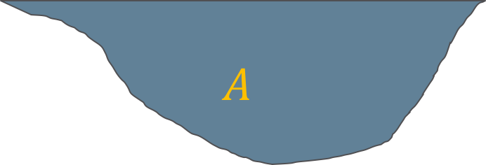
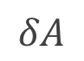
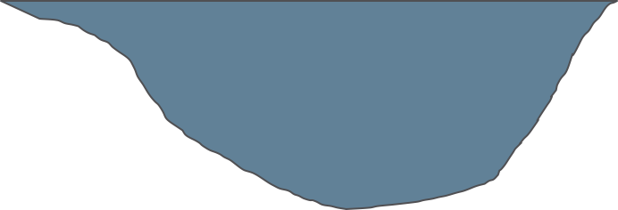
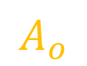
The model (3)
Manning’s equation
Log-transform
Adjust for SWOT observables

Slide 10
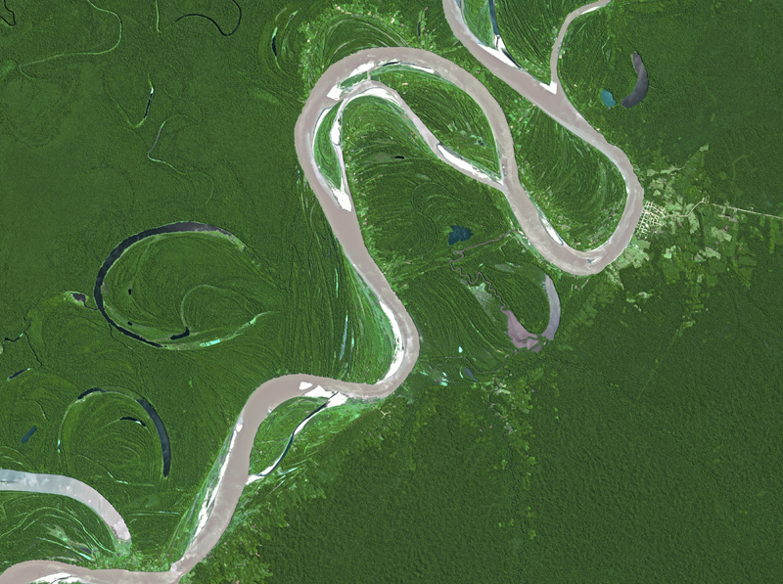
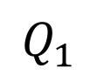
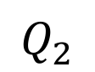
The model (4)
Manning’s equation
Log-transform
Adjust for SWOT observables
Index in time and space

Slide 11
The model (5)
Manning’s equation
Log-transform
Adjust for SWOT observables
Index in time and space
Mass conservation

Slide 12
The model (6)
Manning’s equation
Log-transform
Adjust for SWOT observables
Index in time and space
Mass conservation
Rearrange, acknowledge error

Slide 13
The model (7)
Observables vary in time and space
Quantities of interest vary in time or space (not both)
Random error

Slide 14
The model (8)
Observables vary in time and space
Quantities of interest vary in time or space (not both)
Random error

Slide 15
The model (9)
Observables vary in time and space
Quantities of interest vary in time or space (not both)
Random error

Slide 18
HydroSWOT database
Direct measurement
Stream gages

Slide 19
Results

Slide 20
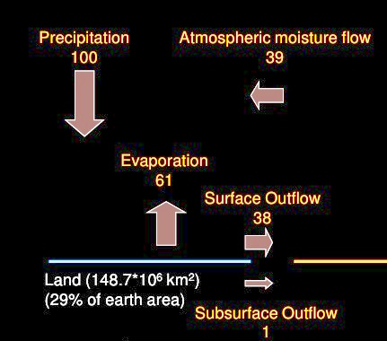
How is Q measured?
Direct measurement
Stream gages
Great for USA
Less great for Africa
Q = P – ET

Slide 21
How is Q measured?
Direct measurement
Stream gages
Water-balance models
Labor-intensive
Labor-, $-intensive
Imprecise
Insufficient data

Slide 22
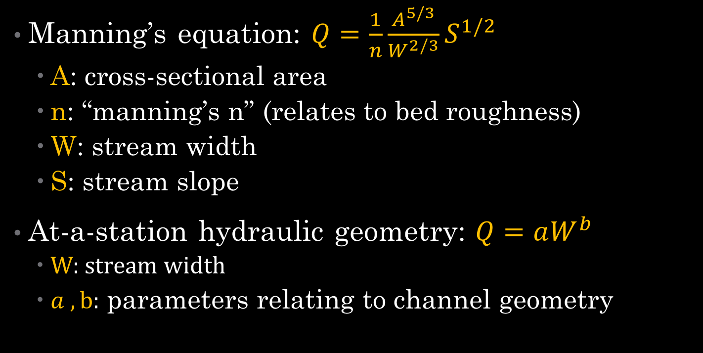
How is Q measured?
Direct measurement
Stream gages
Water-balance models
”Flow laws”
Relate Q to slope, bed material, channel geometry

Slide 23
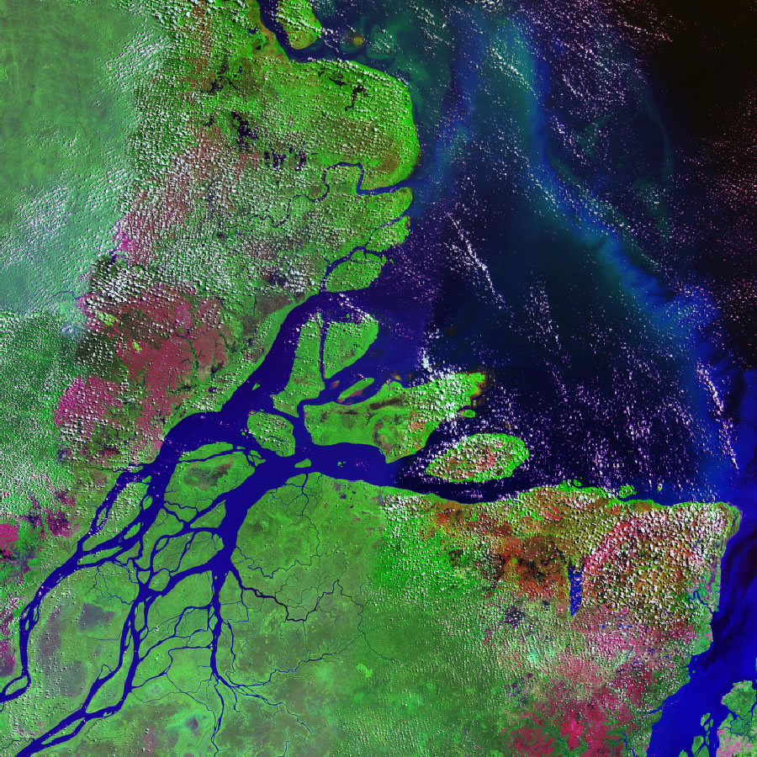
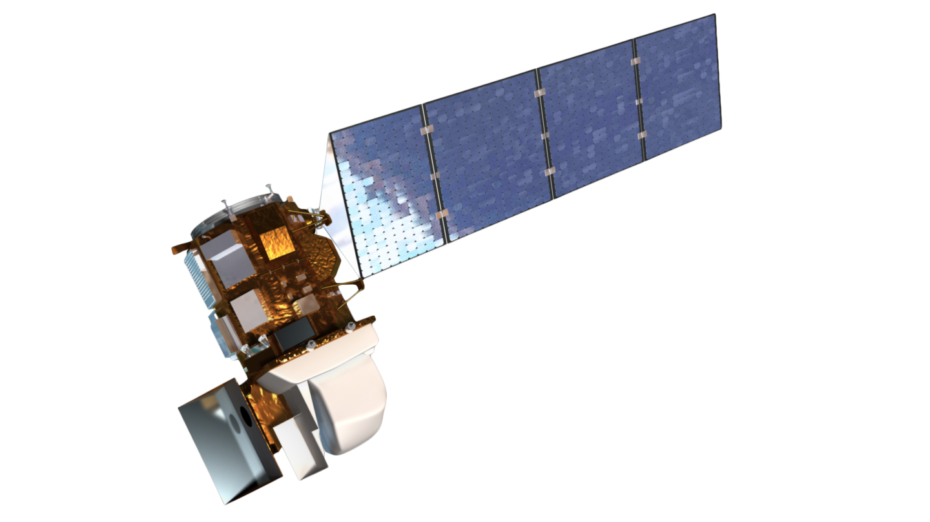
More on ”flow laws”

Slide 24
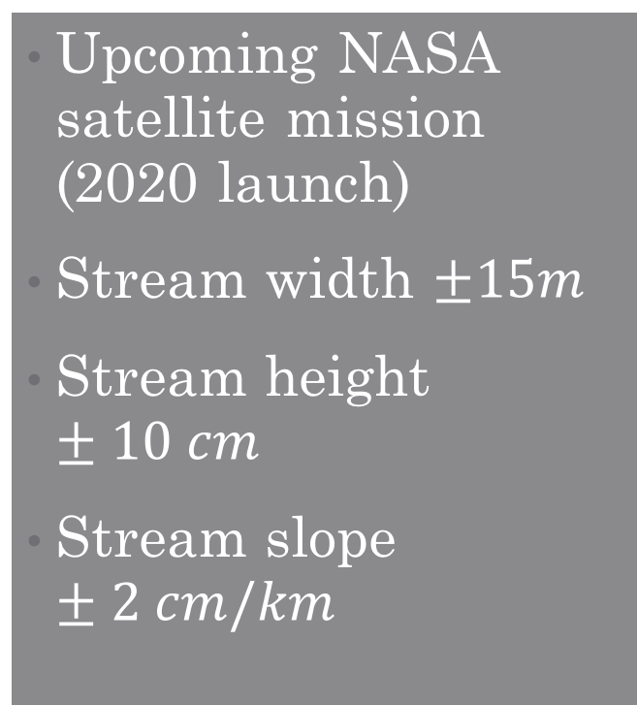
Satellite Remote Sensing
Pictures of Earth from space
E.G. LANDSAT (1972-present)
For any stream reach worldwide!

Slide 25
Surface Water and Ocean Topography (SWOT)

Slide 26
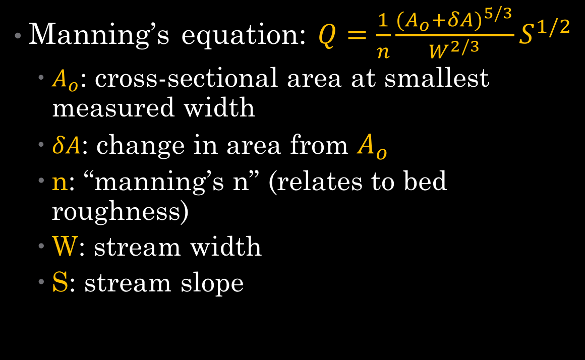
Can we get Q from SWOT measurements?
(Using flow-law equations)

Slide 27
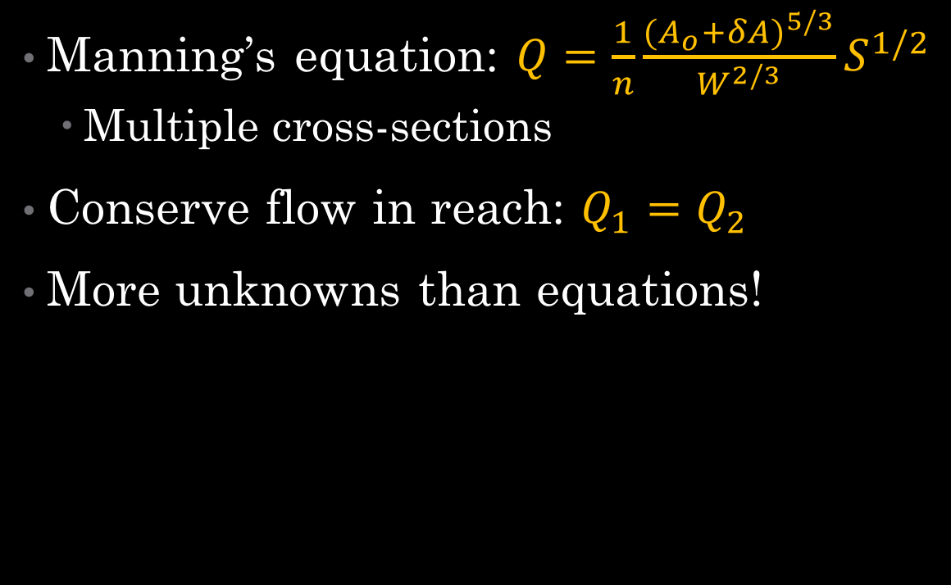
Can we solve the flow-law equations?

Slide 28
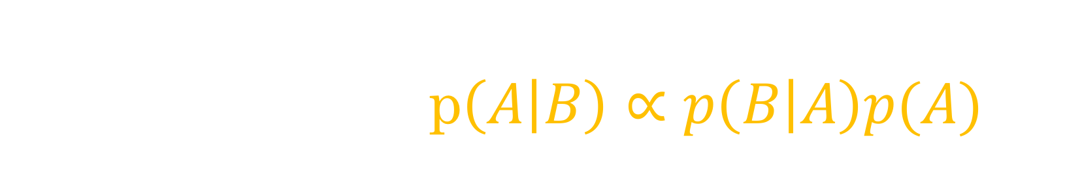


Can we solve the flow-law equations?
???
0
0
Q
Q

Slide 29

Describe and constrain uncertain quantities
Get a distribution for unknowns
Computationally expensive
parameters {
vector[nt] logQ;
real logn;
real<lower=30> Ao[nx];
}
model {
logn ~ normal(logn_hat, logn_sd);
logQ ~ normal(logQ_WBM, cv2sigma(cvQ));
for (i in 1:nx) {
man_lhs[i] ~ normal(man_rhs[i], sigma_man);
}
Ao ~ lognormal(logAo_hat, logAo_sd);
}

Slide 30
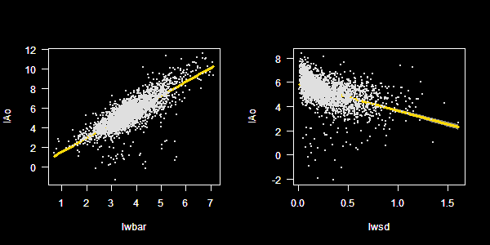
Bayes with Stan language
Code looks like math!
Bayes-specific, Bayes-optimized
Open-source
Plays nice with scientific computing environments

Slide 31
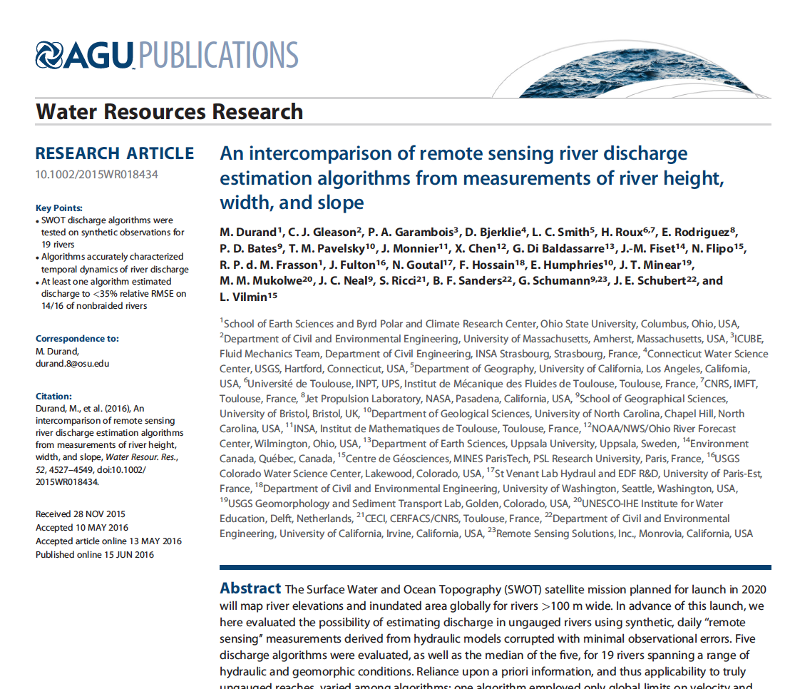
Constraining “prior distributions”
Ao relates to width statistics
Wider rivers are deeper on average
More width-variable rivers are shallower on average
n: from literature

Slide 32
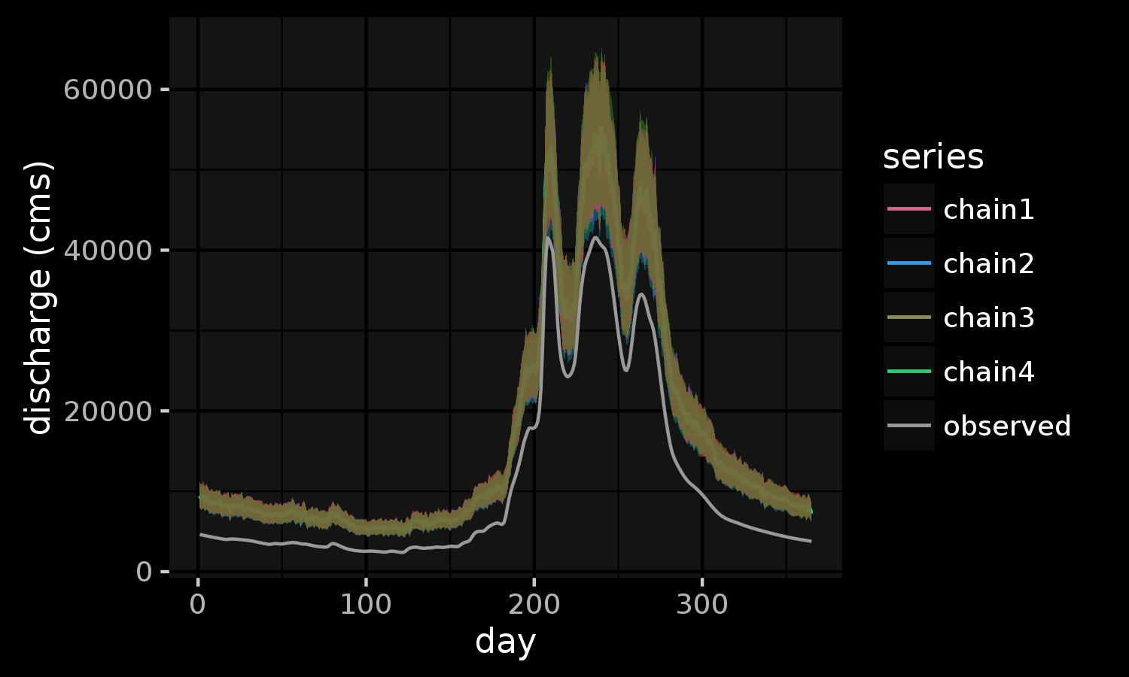
“Data”
HEC-RAS model output
Slope, width, height
19 rivers
“Pepsi Challenge” paper

Slide 33
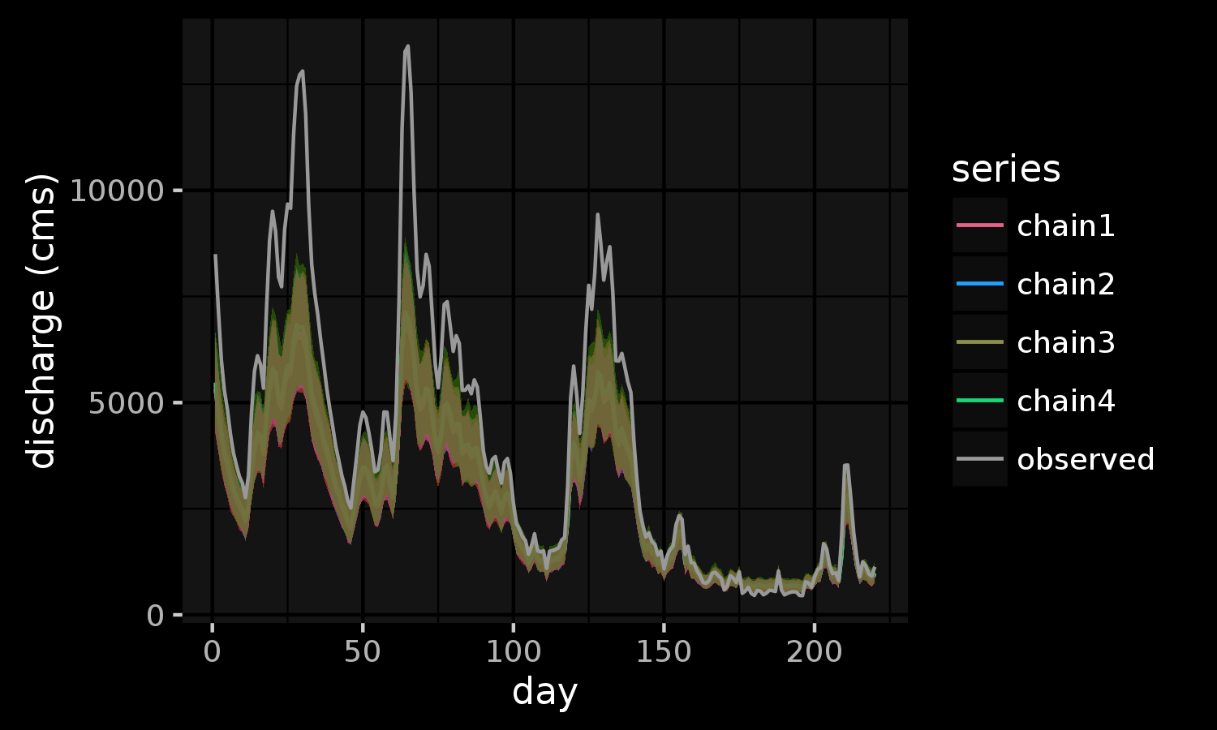
Results - Ganges

Slide 34
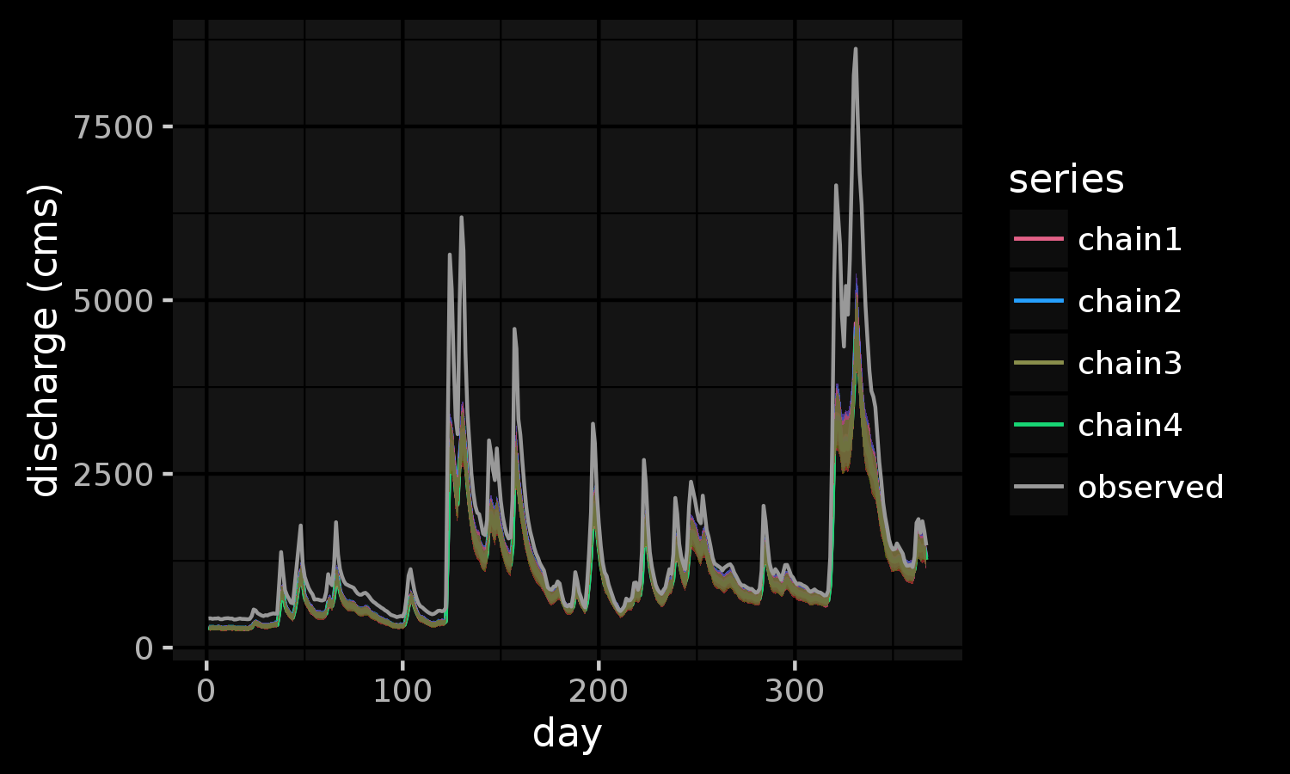
Results - Ohio

Slide 35
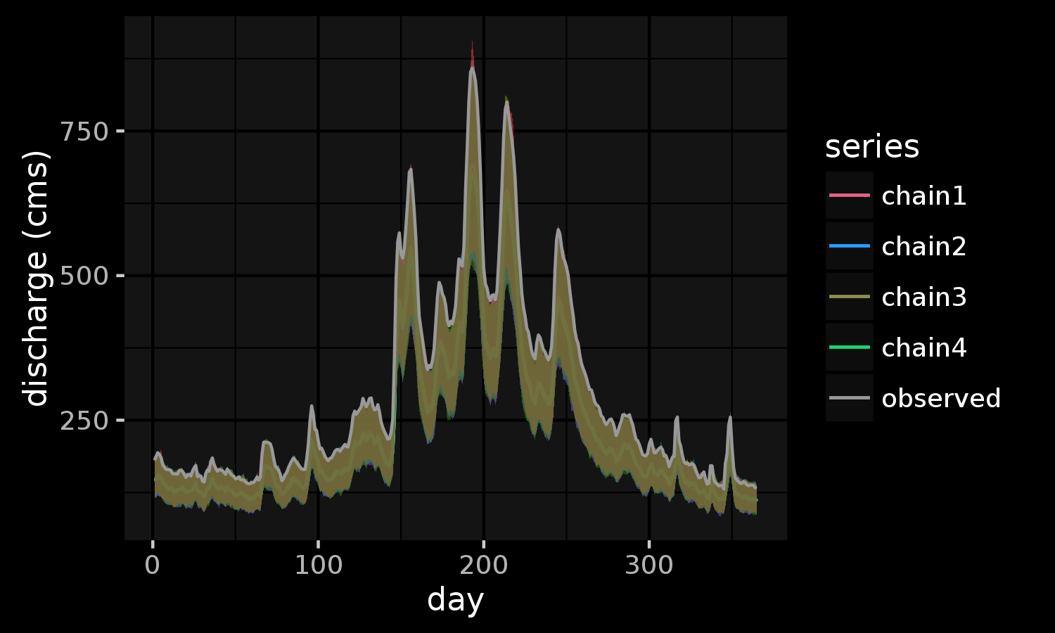
Results - Po

Slide 36
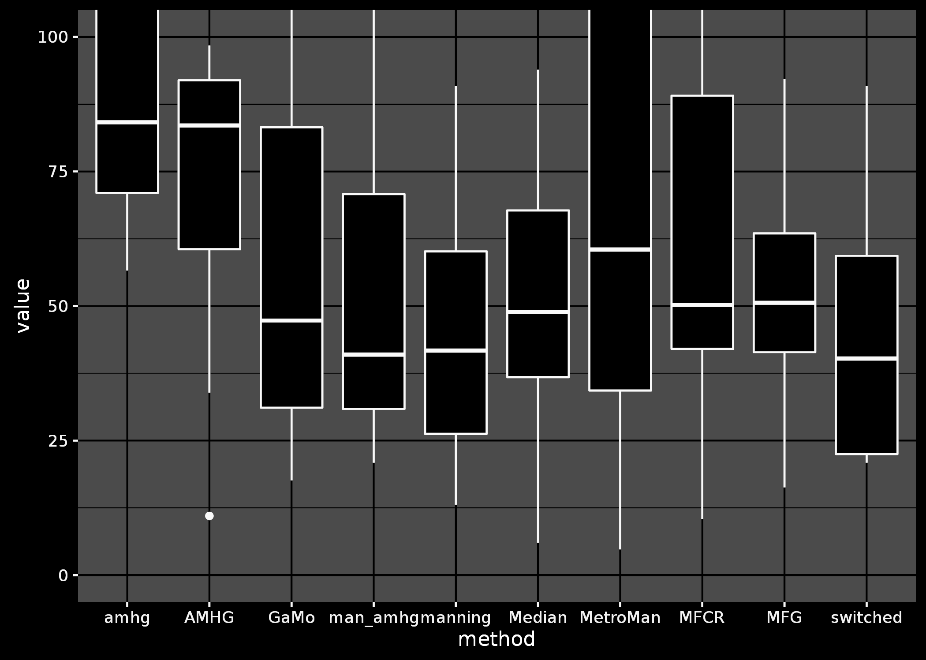
Results – Seine
Worse
Better
Comparing different algorithms (Pepsi Challenge)

Slide 37
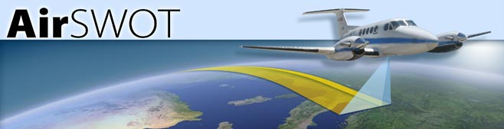

Slide 38
Next steps
Validate using *actual* data
Field datasets
airSWOT
Better constrain Manning’s n
Not actually constant
Computer vision / deep learning for Q

Slide 39
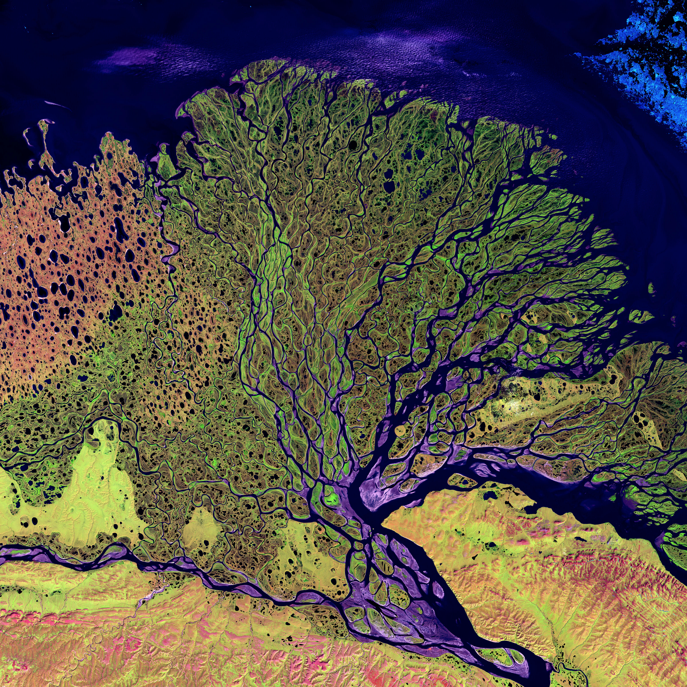
Conclusions
Global-, continental-scale stream flow (Q) not well constrained
The upcoming SWOT satellite will measure many quantities used by flow-law equations to calculate Q
Bayesian inference using Stan used to estimates Q in an underconstrained mathematical system
Our method (Bayesian Manning’s equation) outperforms other SWOT discharge algorithms on average

Slide 40
Thanks!

Slide 41
Thanks!

